Slide 1

Welcome to Room 146
Mr. Besbeas
4th Grade
Please write any questions you may have during the presentation down and email me after the presentation.

Slide 2
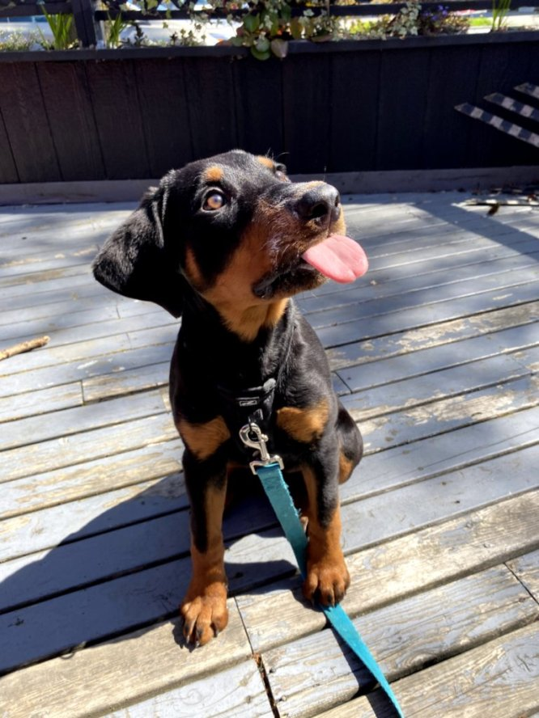
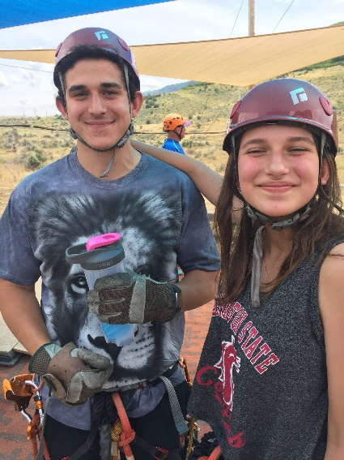
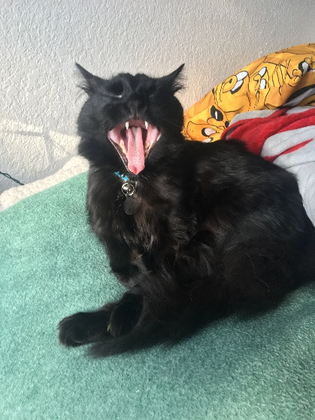
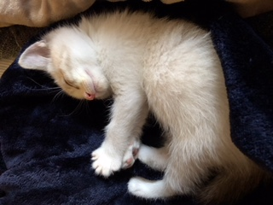
About Me!
I am in my seventh year of teaching in Issaquah! I worked at Creekside as a fourth grade teacher for two years. This is my fifth year at Discovery.
Graduate of WSU, Bachelors in Elementary Education (K-8), and Minors in Psychology and Human Development.
I have two cats Copper and Apollo! I have one dog named Blitzen!
I am married to a teacher! ☺

Slide 3
My Mission Statement
My goal is to…
  Model respect, kindness, safety, and responsibility for every student.
  Provide all students with strategies to manage themselves well.
  Provide all students with tools to navigate any situation with respect, kindness, and responsibility.

Slide 4
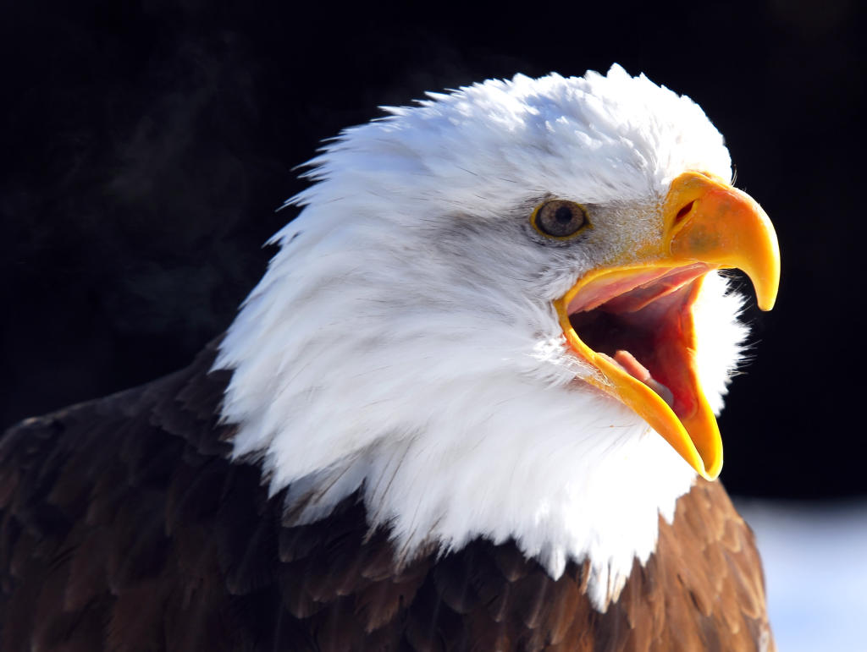
Discovery Way
Classroom Expectations
Be Responsible
Be Safe
Be Kind

Slide 5
Behavior and Classroom Policies
Emphasis on problem-solving
Positive noticing of the desired behaviors
Classroom incentives
-Whole Class: Points/Marble Jar
-Table Group: Points/Eagle Buck Reward
-Individual: Class Economy (Earn Eagle Bucks)

Slide 6
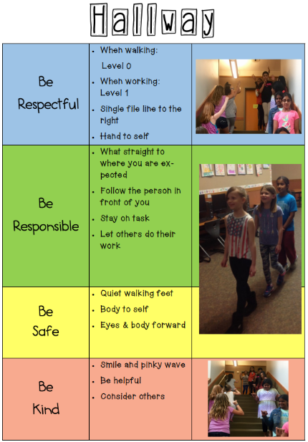
Positive Behavior Social Emotional
Support (PBSES)
“The Eagle Way” –Be Responsible, Be Safe, Be Kind
  Students are taught what this looks like in different areas of the school – classrooms, hallways, Café, Playground, busses…
  There are posters around the school to remind students what is expected.
Eagle Coins – Students earn these for demonstrating the expectations and get recognized as a class when they reach certain landmarks.
Social Emotional Learning– We’re using the Second Step Curriculum to teach these critical skills. These lessons are taught by the counselor and teachers.
Notes:
To be successful, our PBSES program needs to be a partnership between home and school.
Please refer to the handout to see a couple simple things you can do at home.

Slide 7

Technology
  What technology are we using in the classroom this year?
  PowerPoint presentations
  Word
  Teams
  Zearn
  I-Ready

Slide 8
Newsletters
Every Fridays I will send home a newsletter via email.
Newsletter will have important information and dates of upcoming events.
The Newsletter will also talk about curriculum/our work in the classroom each week!

Slide 9
Schedule
Specialist Schedule
  PE: Wednesday/Friday 10:30-11:00
  Music: Monday/Thursday 10:30-11:00
  Library: Tuesday 10:30-11:00

Slide 10

Essential Learnings
Overarching Goals:
Establish a safe learning community where students know and respect each other
Establish structures and routines supportive of learning
Engage students in thinking and sharing ideas about literacy, math, social studies and social emotional learning

Slide 11
Fidgets
Fidgets should only be used if a prior discussion has been had with me.
Please let me know if you feel like your student would benefit from using a fidget.

Slide 12
Homework
Research shows that there is not a connection between homework and academic success at the elementary level!
I do not want homework to be stressful or very challenging for students. I find that leads to frustration for students and families!
Students should be able to do homework independently, and work toward independently setting time to do homework each night and bringing it to school on time.
-In 4th grade, we expect students to complete 40 minutes of homework each night. 4th graders are expected to read for 20 minutes each night, and do math homework for 20 minutes each night. Homework is not graded but is reviewed. Homework is expected to be completed independently by each individual student. The time spent on homework is more important than the amount of homework completed. We do not want homework to be stressful.
-I am happy to modify homework as needed to meet the academic needs of the student. If you have any concerns about the amount or challenge level of homework, please contact me.

Slide 13
Reading at Home
Students should try to read 20 minutes every night!
  They can read independently.
  They can read to someone else.
  Listen to a book on tape.

Slide 14
Friday Folders
Missing homework assignments will be recorded.
Students that complete all of the week’s homework will receive a checkmark.
Each homework assignment counts as one point.
Parent signature is required.
Students that finish all of their homework will have an extra recess for Finish Friday.
Students that need to finish one or more assignments will go to the work room to do makeup work.
Students should have a Green Friday Folder Sheet already! ☺

Slide 15
Classroom Economy
We will be using a classroom economy this year as an individual incentive system.
Students will earn Eagle Bucks for following expected behavior throughout the school day.
Students can buy privileges with Eagle Bucks such as homework passes, teaching the class a skill, or sitting in the teacher chair for the day.
Students will also have jobs with a salary! ☺

Slide 16
4th Grade Quality Work/ Best Effort
Best handwriting
Take your time
Correct spelling
Start a sentence with a capital and end with appropriate punctuation.
Double check work
Turn work in on-time (by Friday)!

Slide 17
Eureka Math – A Story of Units
A comprehensive curriculum written by a team of teachers and mathematicians who took great care to present mathematics in a logical progression, preparing students to understand advanced math
Developed specifically to meet the math standards adopted by our state
Connects math to the real world in ways that take the fear out of math and build student confidence
Teaches math as a “story” to build students’ mathematical knowledge logically and help them achieve deep understanding
This approach can be unfamiliar to those of us who grew up memorizing mathematical facts and formulas

Slide 18
Eureka Math – How Parents Can Help
Understand that students are learning math in a way that will prepare them for the higher demands of college and careers today and in the future – focused math skills and real-world, challenging problems
At the beginning of each module, read the Parent Tip Sheet to get an overview of the topics your child will be learning and how you can support this learning at home
Recognize that Eureka Math lessons can be customized by teachers to meet the varying needs of students

Slide 19
Science
  Vision and Light
  Earth’s Features
  Energy Conversion
  Waves, Energy, and Information

Slide 20


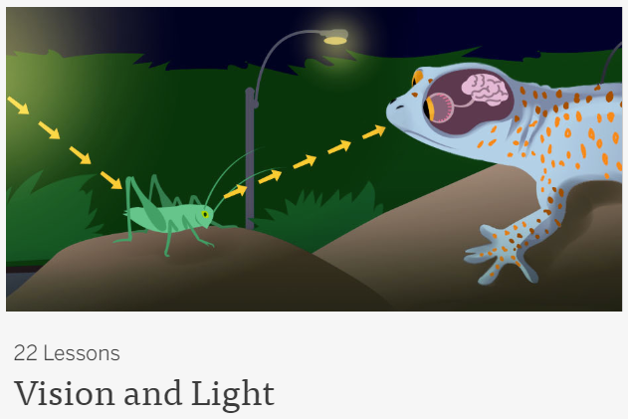


New science curriculum designed to teach current WA State science standards.
Using real-world contexts, students investigate, talk, read, write, think, and argue like real scientists and engineers.
Implementing 2 units in the second half of the year, after finishing Social Studies
4th grade units

Slide 21
Investigating Animal Eyes
Students investigate why there is a decline in the number of Tokay geckos living in one area of a rainforest in the Philippines. They plan and conduct investigations and analyze data related to animal senses to figure out cause-and-effect relationships between environmental changes, the parts of an animal’s vision system, and the animal’s ability to see well. They make models and write explanations to share what they learn about how animals’ body structures perform functions related to senses and survival.
Mystery in Desert Rocks Canyon
In the role of geologists, students investigate a fossil and the geologic history of the area where the fossil was found. Students write scientific arguments about how the fossil formed and what the environment of that area was like in the past. They gather evidence for their arguments by finding patterns in rock layers, reading science books, and using digital and physical models. They analyze rock layers to draw conclusions about times of stability and times of change in the environments of a particular place.

Slide 22
Social Studies
Washington Tribes
Pacific Northwest Explorers
Early industries that developed the territory
Special economic regions of Washington
Tribal vs. Local government

Slide 23
Reading
Balanced Reading Approach- students will read books at their own level
Luck Calkins Reading is our reading comprehension program
Guided reading groups are used to work on specific skills (shared reading and independent reading)
Fountas and Pinnell may be used to identify your child’s level
I-Ready Reading
 | 4 | T+ | U+ | V+
Grade | 3 | Q-S | R-T | S-U
4 | 2 | P | Q | R
 | 1 | Below P | Below Q | Below R

Slide 24
Word Work (Spelling)
This year we are continuing a new spelling program.
This program will meet students at their level.
Students will be in groups and asked to complete different tasks during rotations (four days a week).
-Meet with Teacher for Word Sort
-Word Hunt
-What's the Meaning?
-Workbook Activity

Slide 25
Spelling:
Spelling will be integrated with writing instruction, with an emphasis on application in students’ daily writing.
Intermittent checks and observations of daily work conducted throughout the year to assess.

Slide 26
Differentiated Reading:
Small Group Reading:
  Flexible – it changes all the time!
  Groups of 4 to 7 kids
  Apply new strategies with my coaching

Slide 27
Writing
Lucy Calkins Units of Study
*Narrative: Realistic Fiction
  *Informational
  *Opinion
  *Literary Essay

Slide 28

If writing is like a house…
Structure (framework)
Development
(style/accessories)
Conventions (repairs)

Slide 29

District assessment of reading and math skills
Used to inform instruction
Students will take the assessment in September*, January and April
Family reports will be released by ISD in Family Access (Skyward) in October
We will be assessing with I-Ready 3 times this year in reading and math
i-Reay also meets new Washington literacy screener laws. More info is available at
www.issaquah.wednet.edu/academics/assessment/elementary

Slide 30
i-Ready Overview
District assessment of reading and math skills
Adaptive –adjusts level of questions to how students respond
Students will take the assessment in September*, January and April
* 1st-5th grades only in September

Slide 31
Why are we assessing with i-Ready?
Identify student strengths and specific learning needs
To help set learning goals and supports for small group lessons and working with individuals
To monitor growth toward grade level standards
i-Ready phonics and phonological awareness subtests also serve as a state-required literacy screener.

Slide 32
i-Ready Plan
September
1st-5th grade students take the i-Ready reading and math assessments
Teachers use the results to plan learning
  Build on Strengths
  Address learning gaps
October
Family Assessment Reports will be loaded by ISD into Family Access
December
Conferences – will discuss how students are progressing, including any continued learning needs

Slide 33
Learn More
Visit our district web page at:
www.issaquah.wednet.edu/academics/assessment/elementary

Slide 34
Report Cards and GRADES
1st Semester
2nd Semester
4 → consistently exceeds grade level expectations
3 → consistently meets grade level expectations
2 → inconsistently meets expectations
1 → consistently does not meeting expectations,
even with extra assistance/modifications

Slide 35
What earns a four….
TWO things must be true
CONSISTENTLY performing well above expectations
(such as mastery of 5th grade content)
Independently performing above expectations

Slide 36
Parent Communication
Call/Meet:
Before School (7:45 – 9)
After school (3:45 – 4:15)
Emails are GREAT, and I’ll respond within one day!
Newsletters: Sent out each Friday
Phone/Zoom calls- We can schedule as needed

Slide 37
Conferences:
TBA
I’ll email you when the window opens up to sign up for conferences using the online system we used last year.

Slide 38
Smarter Balance Testing
Fourth Grade SBA- TBA
Math
ELA

Slide 39

Smarter Balance Testing
How we prepare:
    Lessons on test strategies
    Special “practice days” prior to the test
    Preparation for explaining their thinking
    TBA! Testing should occur but it can change!

Slide 40
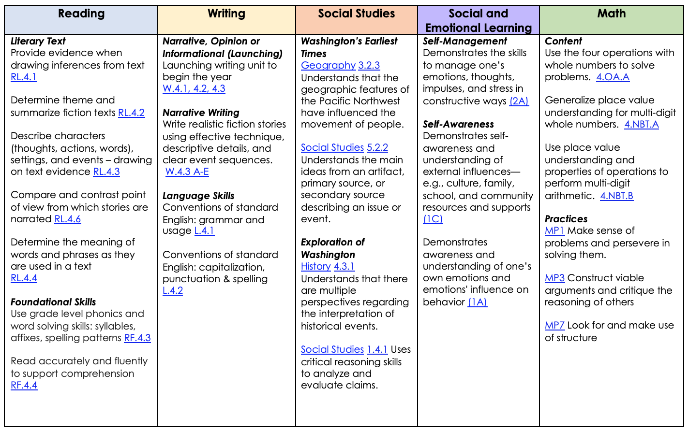
Essential Learnings for 4th Grade – Tri 1

Slide 41
Money Collection
Thank you for paying online!
ISD strongly encourages all payments to be made online…if this is an issue please talk to Angie in the office.

Slide 42

  Over the years,
  the Foundation
  has channeled more than $13 million into our schools, providing opportunities for students at all levels in the Issaquah School District.
  ____________________________________________
  Established in 1987, the Foundation is a community powered nonprofit supporting students.
  The Foundation works to ensure they have the highest quality educational experience possible by funding district-wide programs that are not supported by tax dollars.

Slide 43

How do we fuel success for students?
By investing in a variety of areas that support them.

Slide 44

What funding do we provide?
Academic Support
  Allocation for schools to provide after school tutoring.
  Student Academic Grants for outside tutoring.
Basic Student Needs
  Backpacks & School supplies.
  Food during the school day.
Cultural Bridges
  Building relationships with families from diverse cultures.
Fine arts fund
  Band, orchestra, choir, theater, and visual arts.
Grants for teachers & staff
  Offering opportunities to enrich education.
Parent education opportunities
  Parenting Toolbox & ParentWiser support.
Social Emotional Support
  Expert speakers and professional development.
STEM support
  Robotics clubs, STEM clubs, STEMposium & MORE!

Slide 45

How can you help?
In this rapidly changing educational environment, your support of the Foundation is more important than ever.
Your gift provides all students with programs and resources that inspire innovation, cultivate interests, and respond to emerging needs.
Donate today at isfdn.org

Slide 46
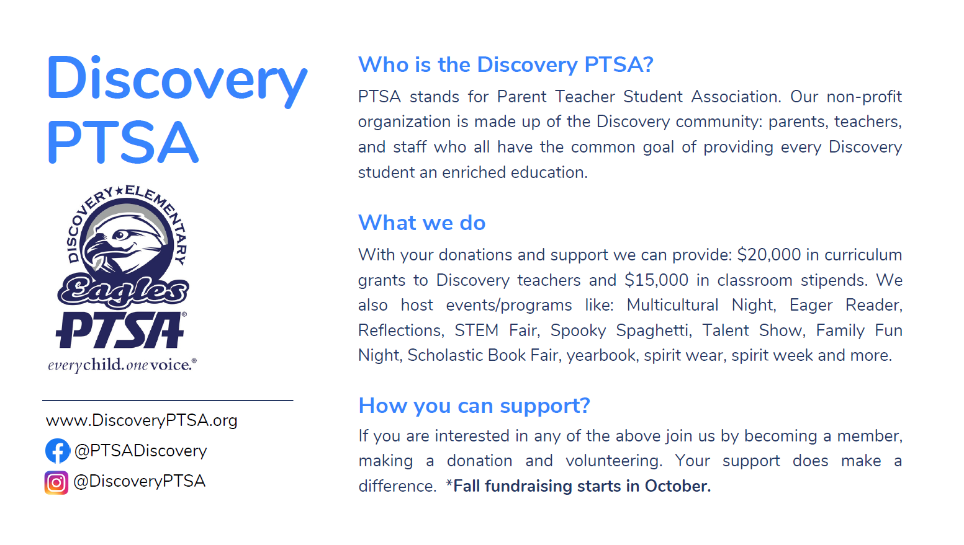

Slide 47
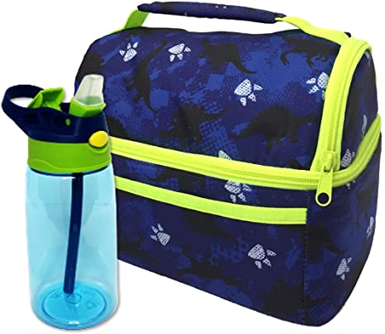

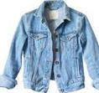
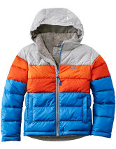

Please write names on lunch bags, water bottles and jackets to help us get items back to students easily.
Lost and Found rack is outside in playground near cafeteria doors during the day
Small lost items like glasses and jewelry will be kept in office

Slide 48
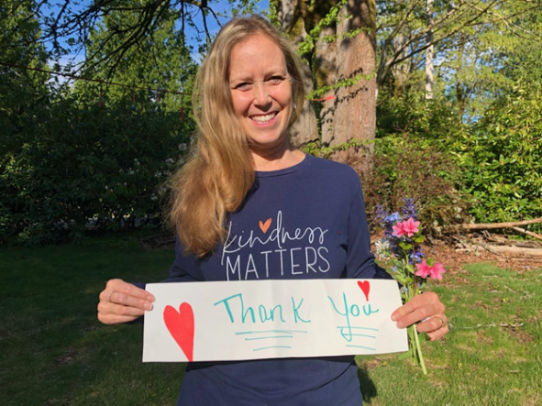
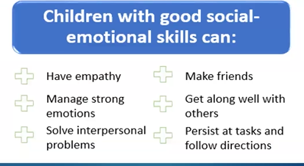
students with their social-emotional needs at school.
.
Hello from our SCHOOL COUNSELOR
Denise Darnell “Miss Denise”
darnelld@Issaquah.wednet.edu
I teach classroom lessons
Collaborate with parents
Help students with friendship or personal challenges
Support students with their social-emotional needs at school.

Slide 49

Thank you!

